Slide 1
EOC ASSIGNMENT - 4
Batch B Group 15
Yeshwanth Balaji (CB.EN.U4AIE22102)
Aswin Ravidev (CB.EN.U4AIE22108)
Sarvesh K (CB.EN.U4AIE22153)
Kishor S (CB.EN.U4AIE22128)

Slide 2
Question 1 (a)
Locate the Max.asm’ and MaxL.asm’ programs in nand2tetris folder and perform the following actions.
Check the correctness of both the program using the CPU emulator. Comprehend the lines of codes.

Slide 3
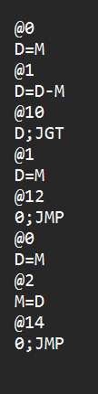
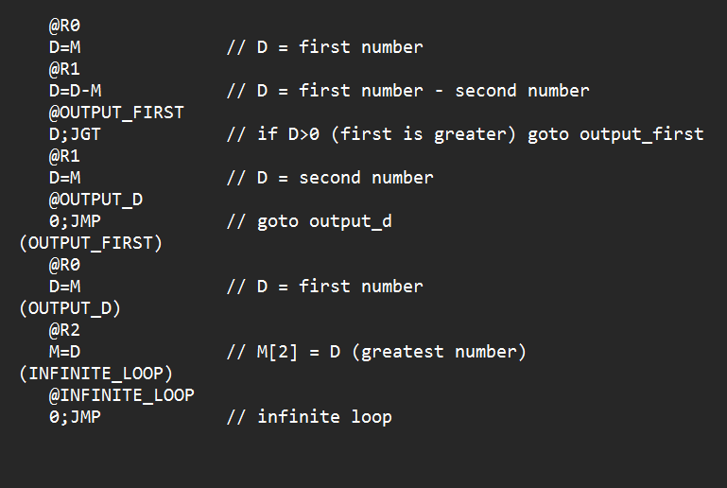
Answer
MaxL.asm
Max.asm

Slide 4
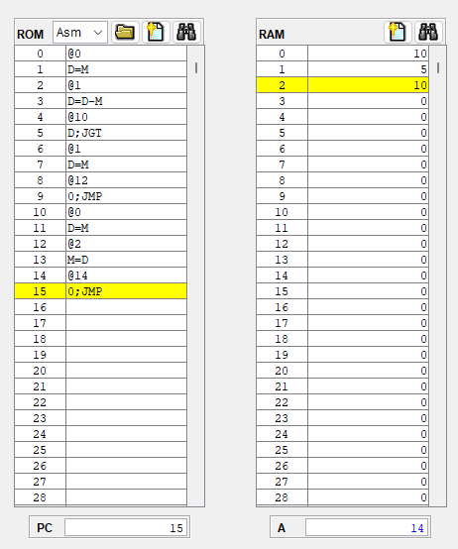
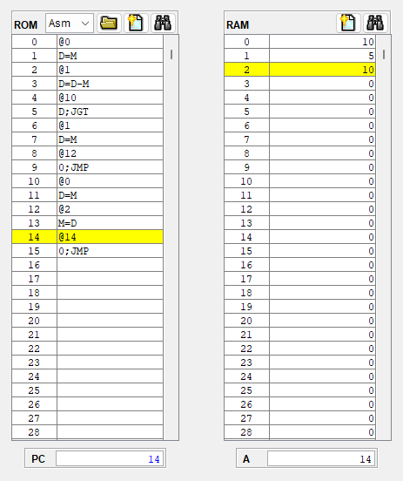
Checking in CPU emulator
Max.asm
MaxL.asm

Slide 5
Question 1 (B) Generate machine code for the ‘MaxL.asm’ program manually. describe/comment on the translation line by line. save the file as ‘MaxL.hack’

Slide 6
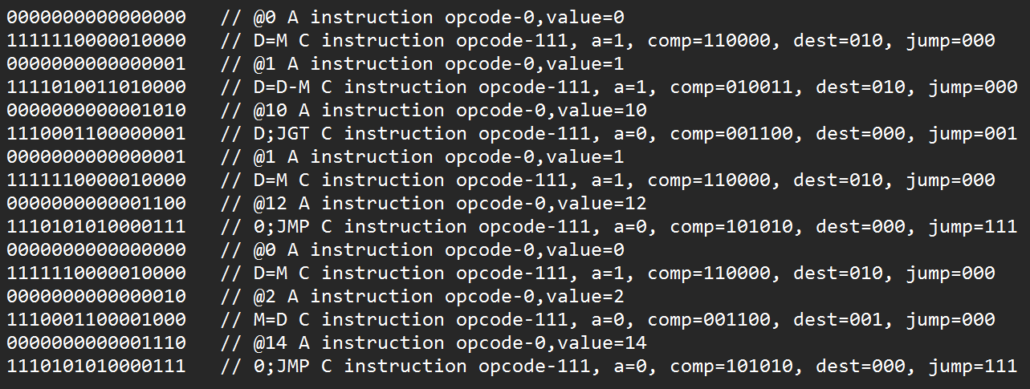
Answer
MaxL.hack
MaxL.asm

Slide 7
Question 1(C)
Develop your own assembler (using python/Java) using limited instruction set used in the program MaxL.asm’. The assembler you developed should translate the input file ‘MaxL.asm’ to ‘MaxL.hack’.

Slide 8
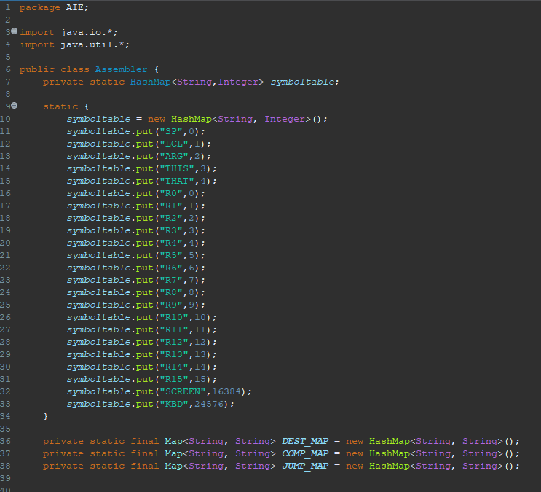
Assembler code in java

Slide 9
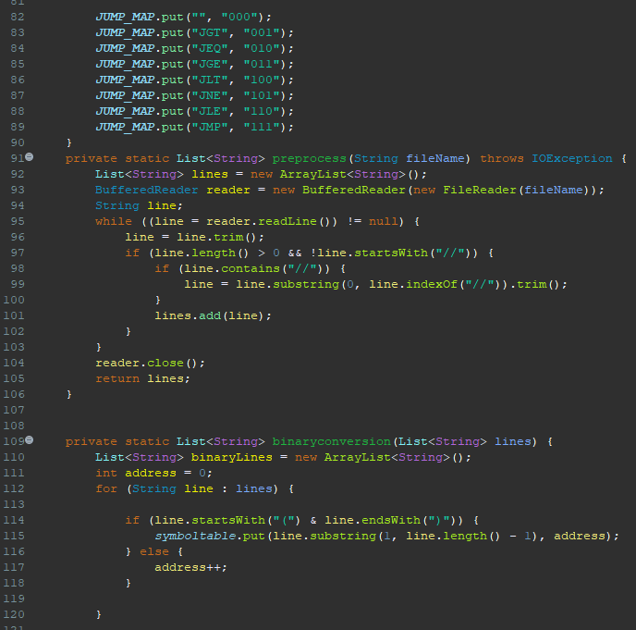
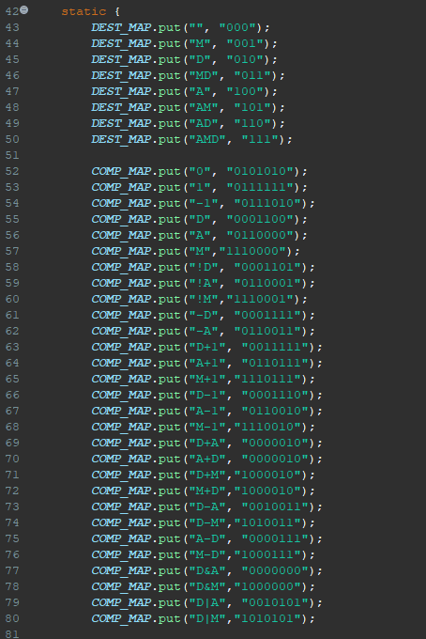

Slide 10
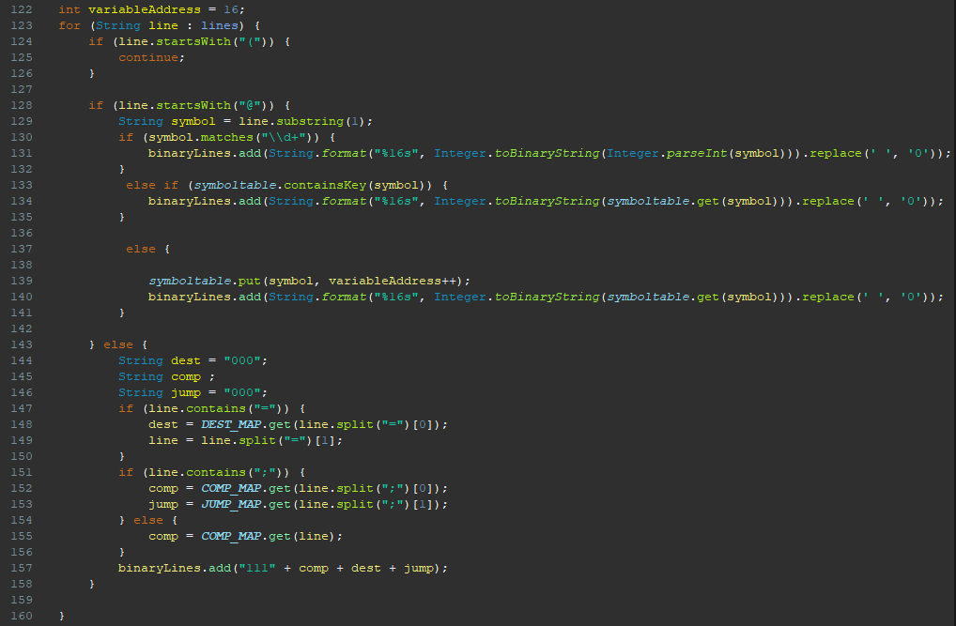

Slide 11
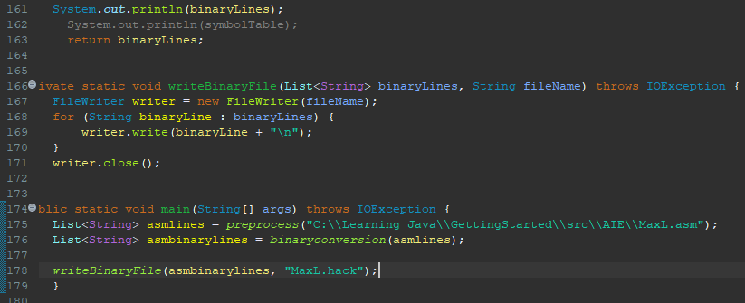

Slide 12
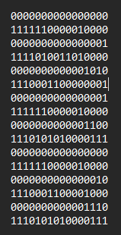
MaxL.hack
MaxL.asm

Slide 13
Question 1 (D)
Verify the machine codes generated by your own assembler and the ‘assembler’ tool provided in the software suite.

Slide 14
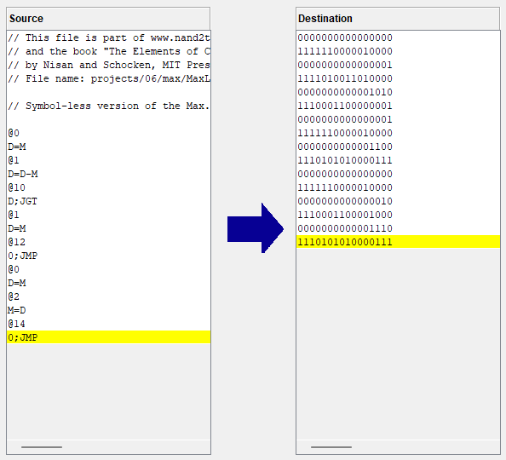
Answer
The first image is the output from our Assembler in Java and second image is the output from inbuilt Assembler in the Software Suite. As we can see the output from both are same confirming that our Assembler is working perfectly.
(1)
(2)

Slide 15
Question 1 (E)
Repeat (c)-(d) for Max.asm

Slide 16
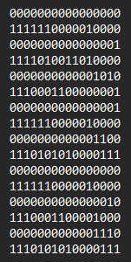
answer
Max.asm
Max.hack

Slide 17
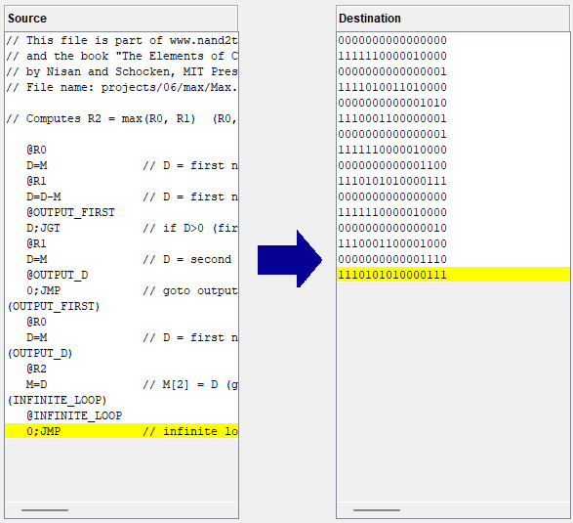
comparing
The first image is the output from our Assembler in Java and second image is the output from inbuilt Assembler in the Software Suite. As we can see the output from both are same confirming that our Assembler is working perfectly.
(1)
(2)

Slide 18
Question 2
Write an assembly language program to find the average of N numbers and save the file as ‘average.asm’
a. Check the correctness of the program using the CPU emulator

Slide 19
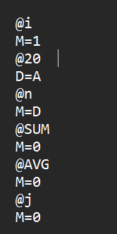
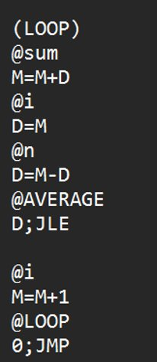
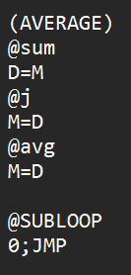
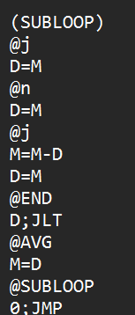
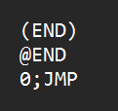
CODE

Slide 20
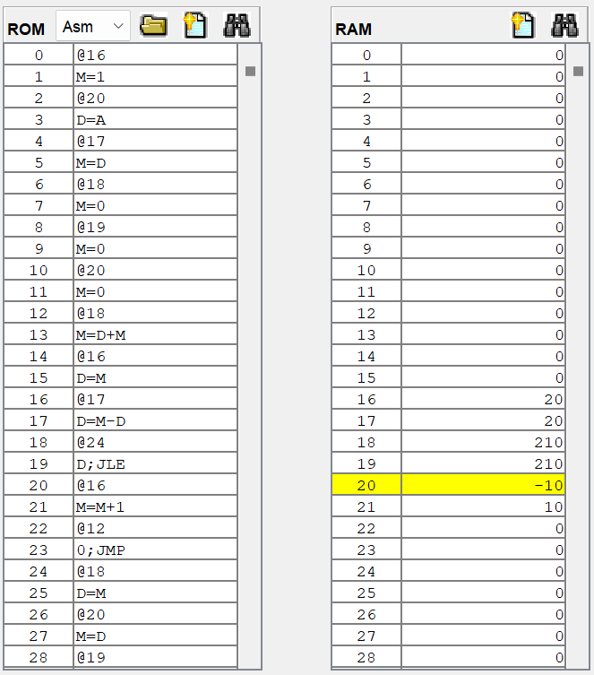
Here we have implemented our code for checking in cpu emulator.

Slide 21
Question
b. Generate machine code for the program manually. Describe/comment on the translation line by line. Save the file as ‘average.hack’

Slide 22
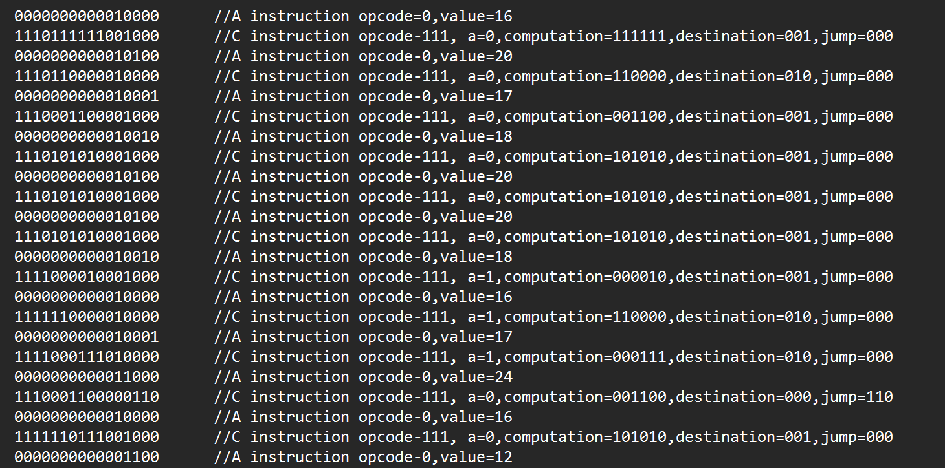

Slide 23
Question
c. Compare the machine codes generated manually and the one generated by the ‘assembler’ tool.

Slide 24
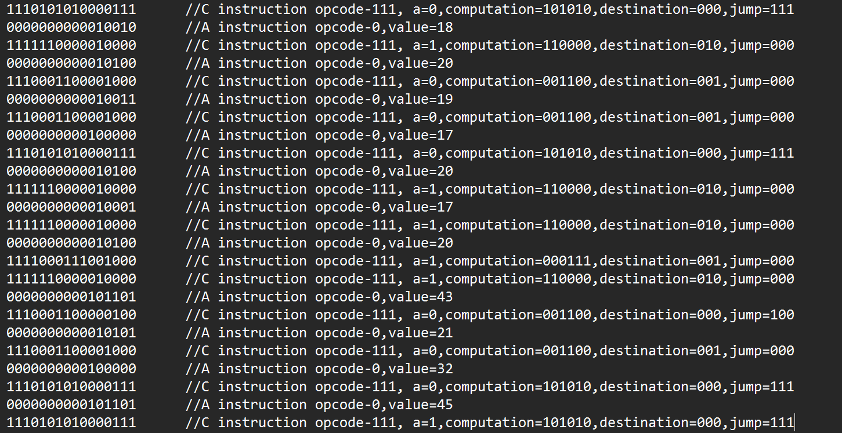

Slide 25
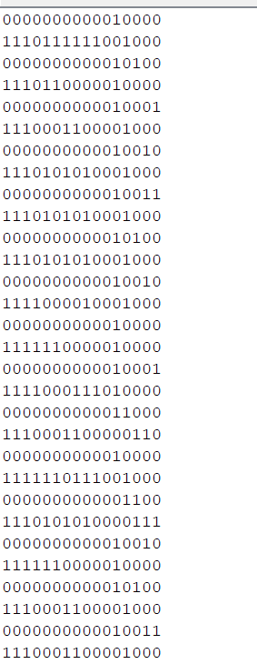
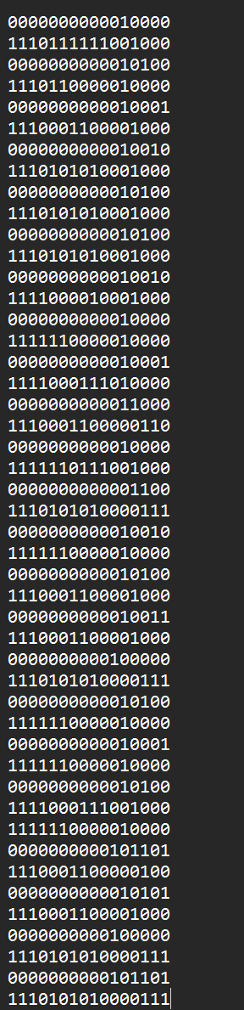
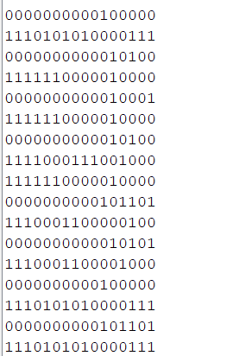
Assemblers
Manual

Slide 26
Contribution
Question 1 – Yeshwanth Balaji (CB.EN.U4AIE22102) – c,e
and
Aswin Ravidev (CB.EN.U4AIE22108) – a,b,d
Question 2 – Sarvesh K (CB.EN.U4AIE22153) – c,b(help)
and
Kishor S (CB.EN.U4AIE22128) – a,b

